Slide 1
Talos
Human Computer Interaction
Prof. Andrew D. Bagdanov
Gabriele Magrini

Slide 2
Index
  Introduction
  Needfinding
  Technical overview and implementation
  Usability testing
  Conclusions

Slide 3
Introduction
Talos is an hybrid application based on a physical device and a dedicated control app, born from the idea of a smart lock freely placeable and highly intuitive.
Objectives:
Create a secure lock controllable from distance
Let the user be able to manage dynamically entrance permission
Notify the user with a smart ringbell

Slide 4
Needfinding
We divide the needfinding process in 3 parts:
Personas: we create fictional personas to summarize potential users of the system
Scenarios: personas are set in scenarios to highlight their necessities
Requirements: we extract and identify the principal requirements for such a system

Slide 5
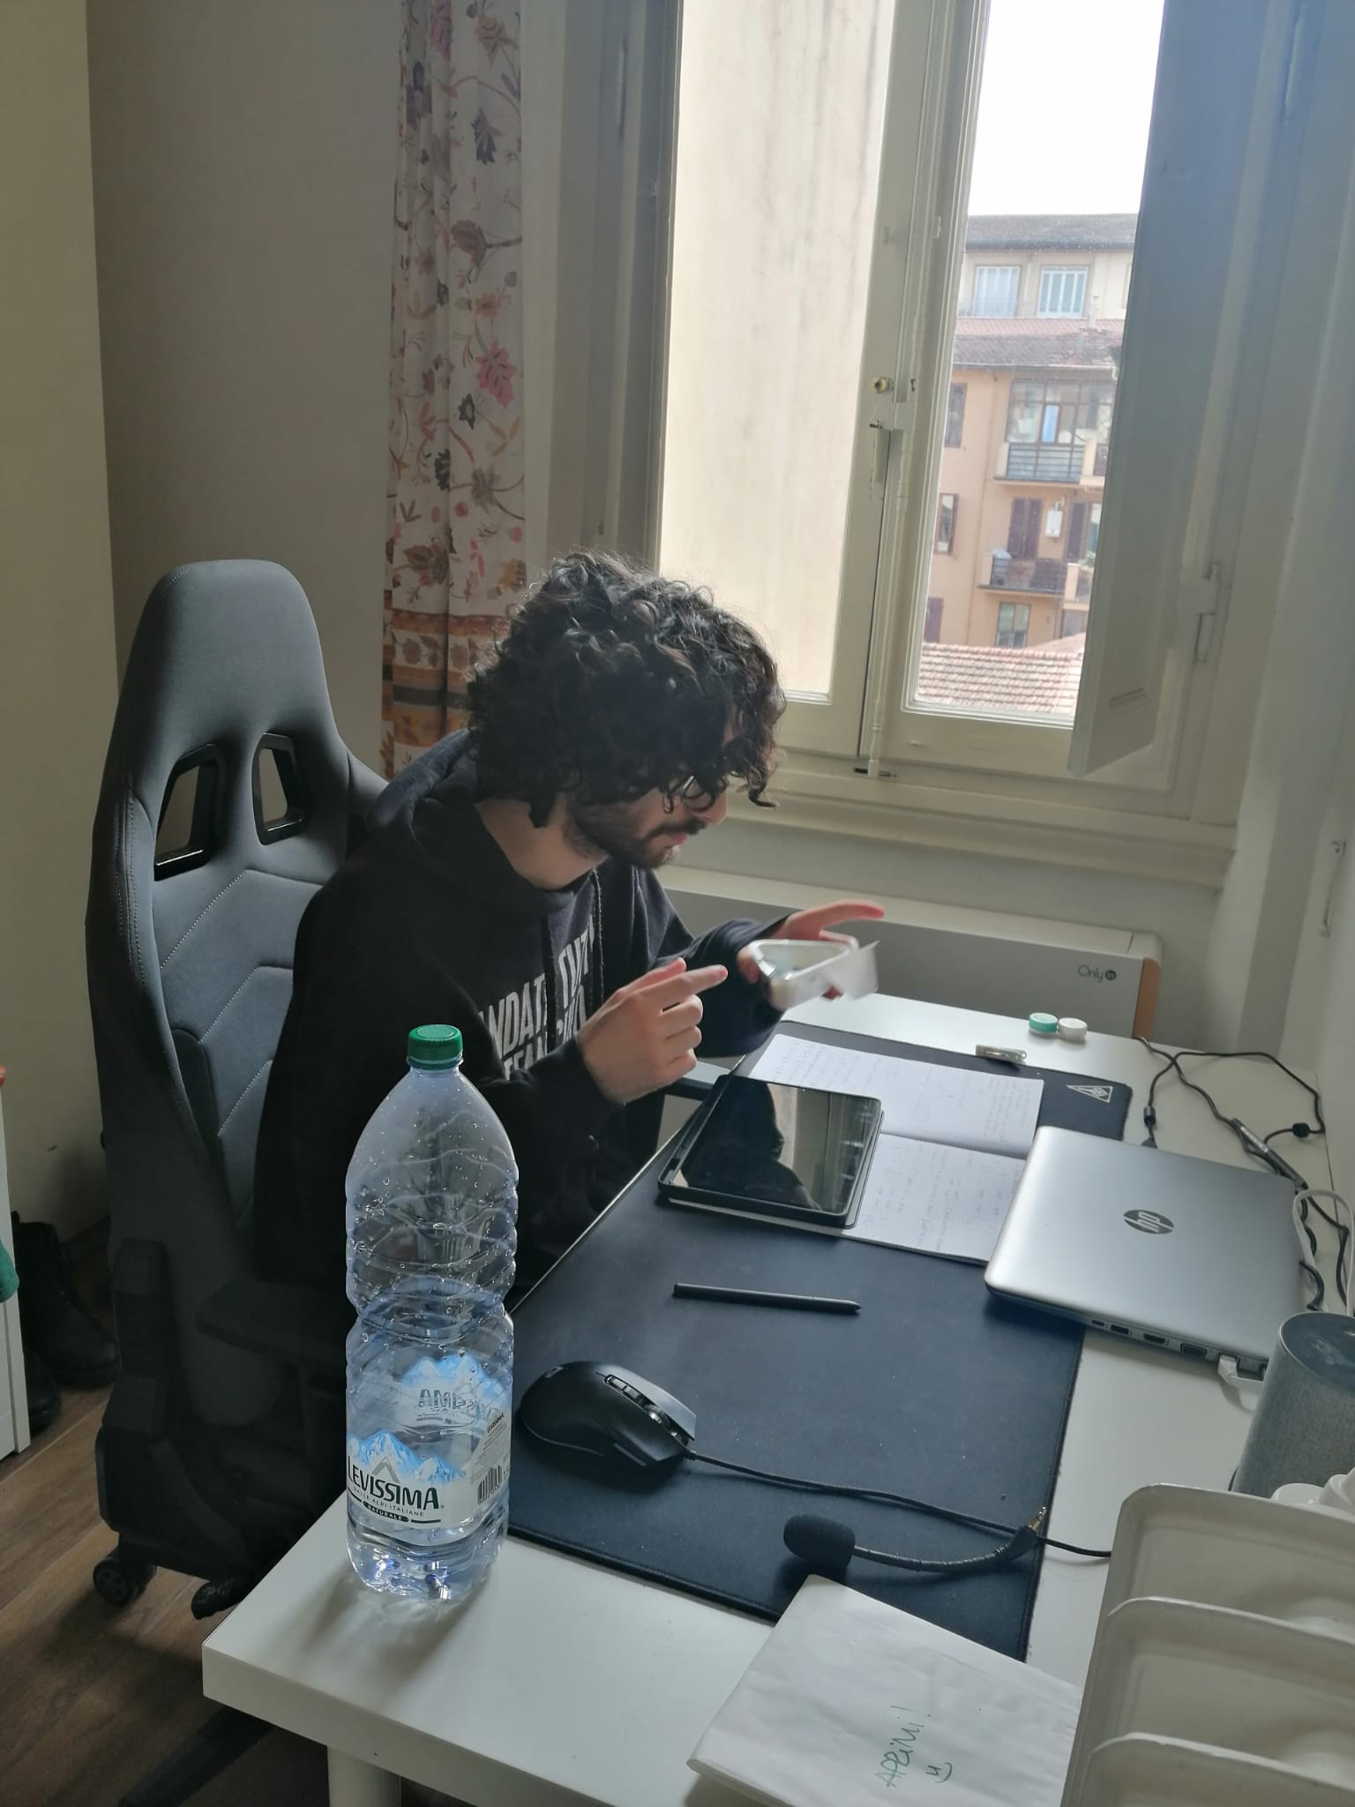
Needfinding - Personas
Francesco: 23 years old college student, studying math.
He loves videogames, and spends much of his day in his room.
When he's in his gaming(or, more rarely, study) sessions, he likes to concentrate on them, isolating a little from his noisy roommates.

Slide 6
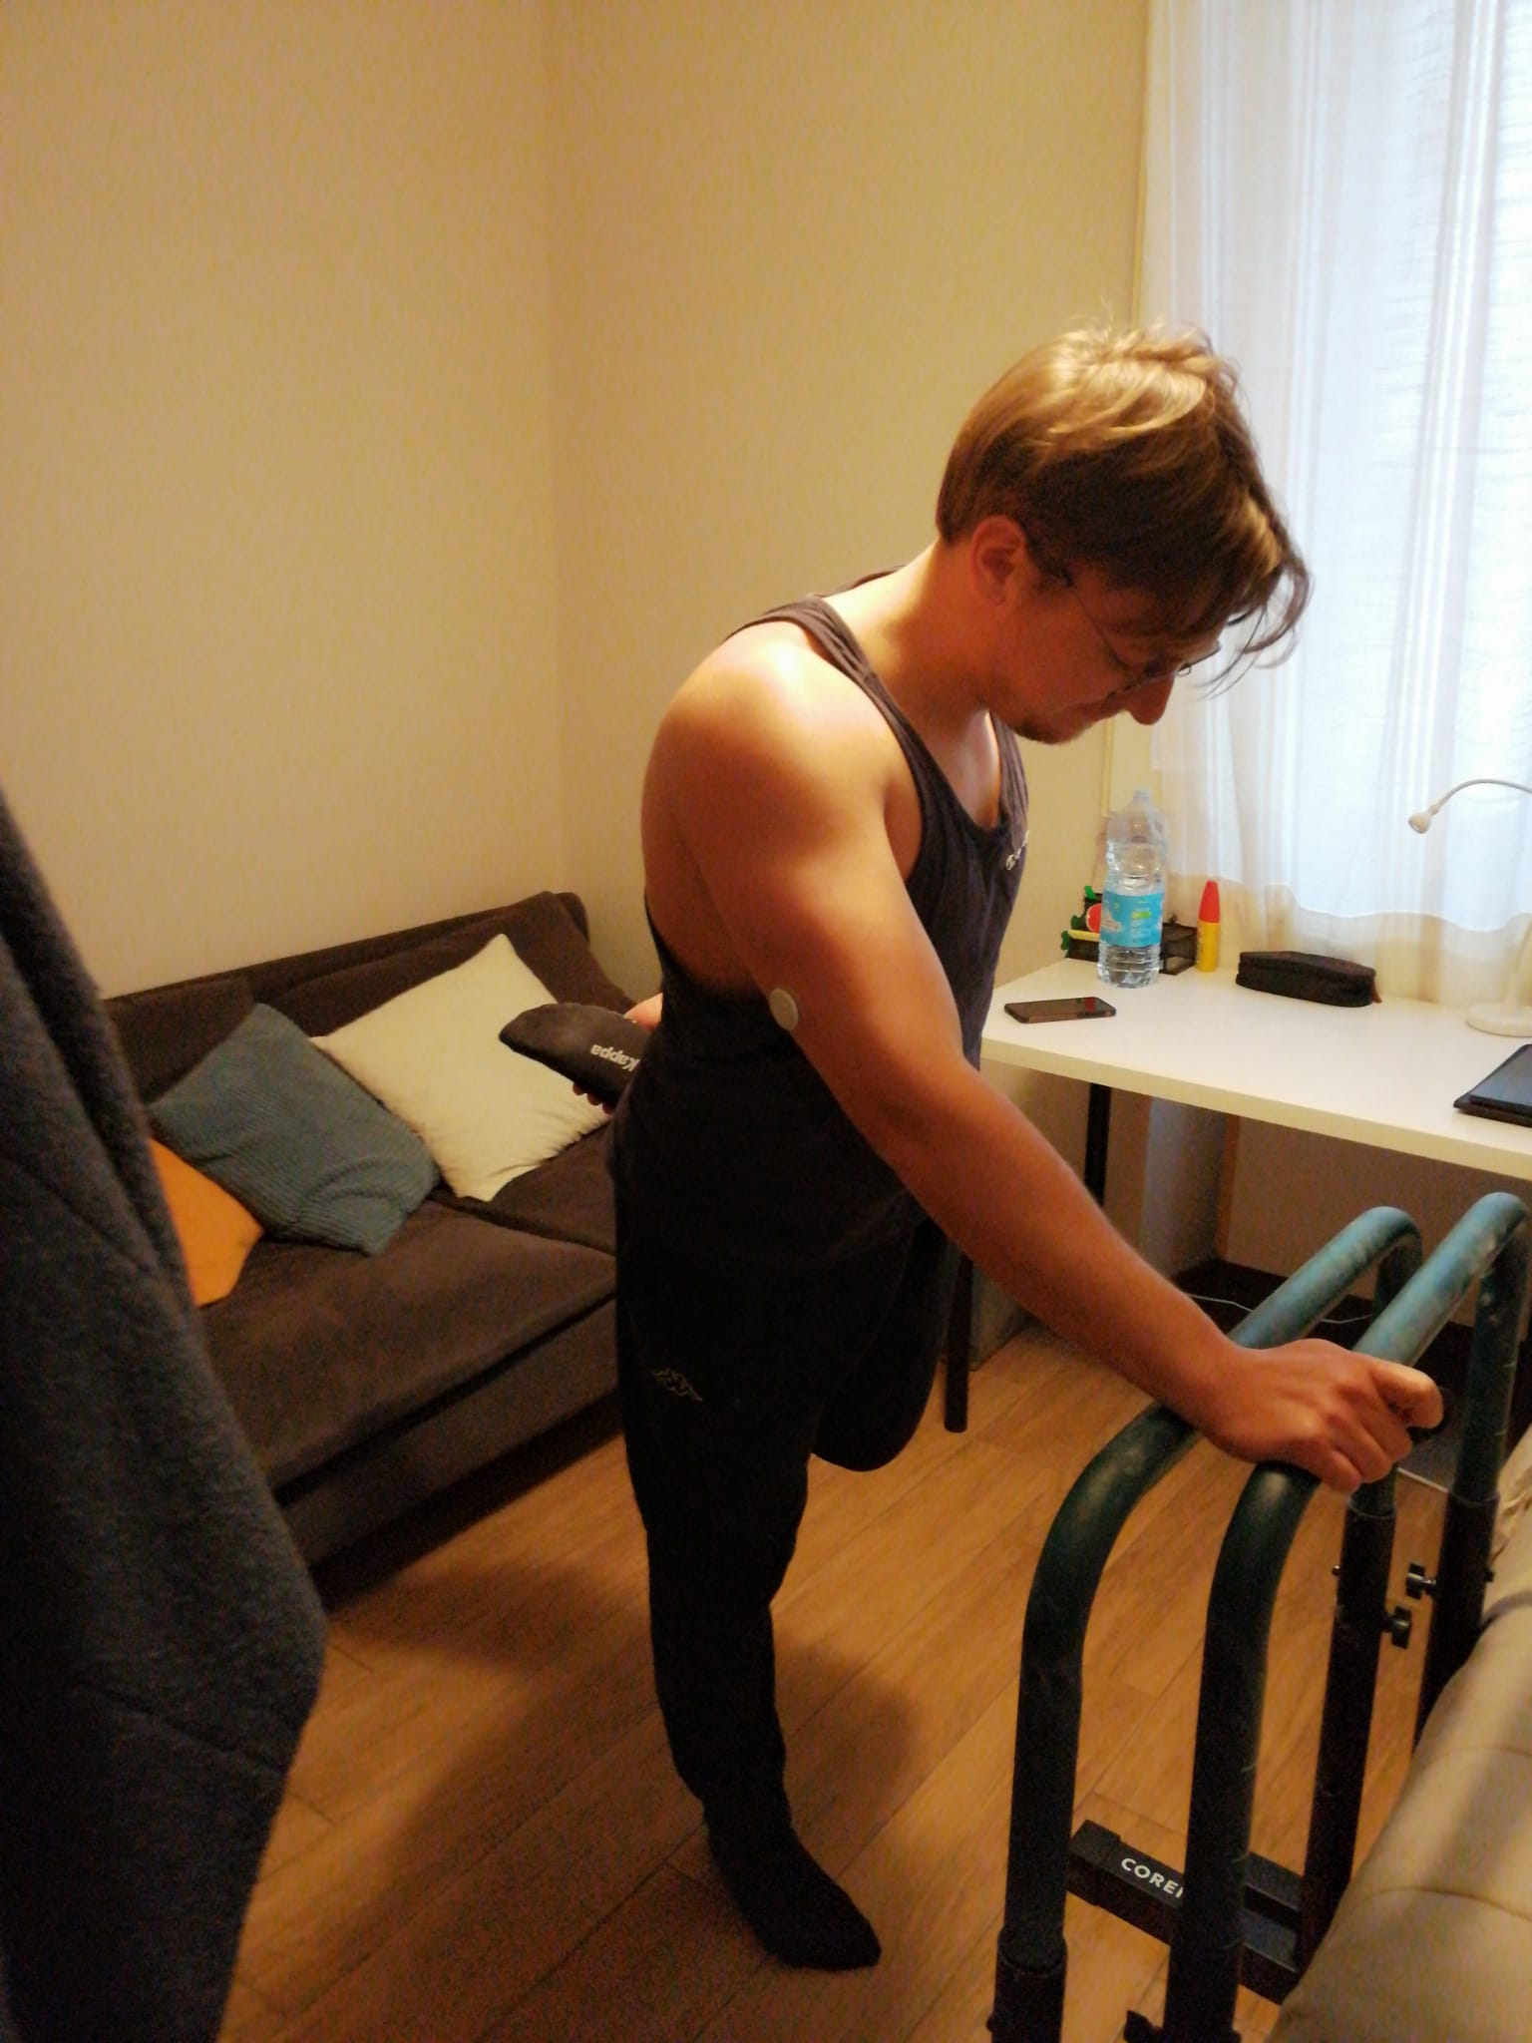
Needfinding - Personas
Emanuele: 22 years old Med student, he has a girlfriend with whom he shares most of his daily routine.
Emanuele loves to reserves himself and with his fiancé moments of intimacy and privacy.
He rarely skips a day of training; overall, he's a very methodical guy that likes full control in his everyday life.

Slide 7
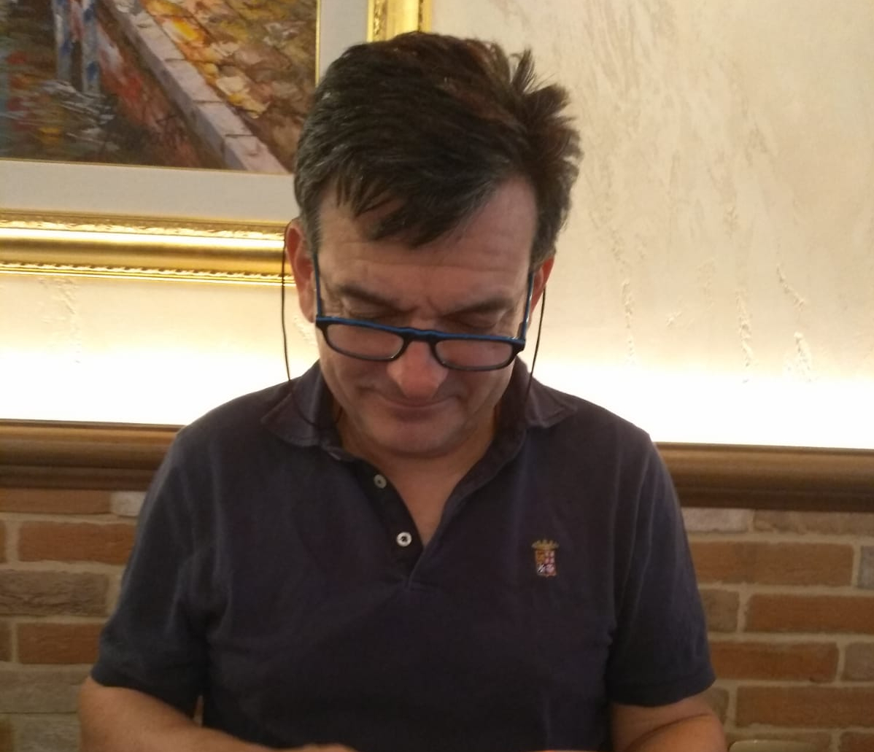
Needfinding - Personas
Roberto: Roberto is a middle aged man, working in a cement factory in the IT department.
He's an old school computer programmer but he still has some difficulties approaching with smartphones and such.
Very practical guy knows all the secrets and needs of the industrial field.

Slide 8
Needfinding - Scenarios
Here the 4 different scenarios hypotesised, summarized in their focal points:
Francesco wants to lock his room to study better, but his roommates request to enter at times. He needs a way to pilot the door lock remotely without leaving his desk.

Slide 9
Needfinding - Scenarios
Here the 4 different scenarios hypotesised, summarized in their focal points:
Francesco wants to lock his room to study better, but his roommates request to enter at times. He needs a way to pilot the door lock remotely without leaving his desk.
Emanuele has to leave his appartment for a while, and would like a way to secure his room while away, having no lock installed.

Slide 10
Needfinding - Scenarios
Here the 4 different scenarios hypotesised, summarized in their focal points:
Francesco wants to lock his room to study better, but his roommates request to enter at times. He needs a way to pilot the door lock remotely without leaving his desk.
Emanuele has to leave his appartment for a while, and would like a way to secure his room while away, having no lock installed.
Roberto has to manage remotely a newly build sector, and needs a way to give access only to a group of colleagues dynamically.

Slide 11
Needfinding - Scenarios
Here the 4 different scenarios hypotesised, summarized in their focal points:
Francesco wants to lock his room to study better, but his roommates request to enter at times. He needs a way to pilot the door lock remotely without leaving his desk.
Emanuele has to leave his appartment for a while, and would like a way to secure his room while away, having no lock installed.
Roberto has to manage remotely a newly build sector, and needs a way to give access only to a group of colleagues dynamically.
Francesco often uses his earphones and can’t hear his roommastes banging on the door, so he need a way to be notified when someone wants to enter his room.

Slide 12
Needfinding - Requirements
Here the principal requirements extracted from the scenarios before:
A way to remotely control the door lock
A clear indicator to visualize the lock status
Create a device easily applicable outside of every door
Notify the request of an external user to have access to the room

Slide 13
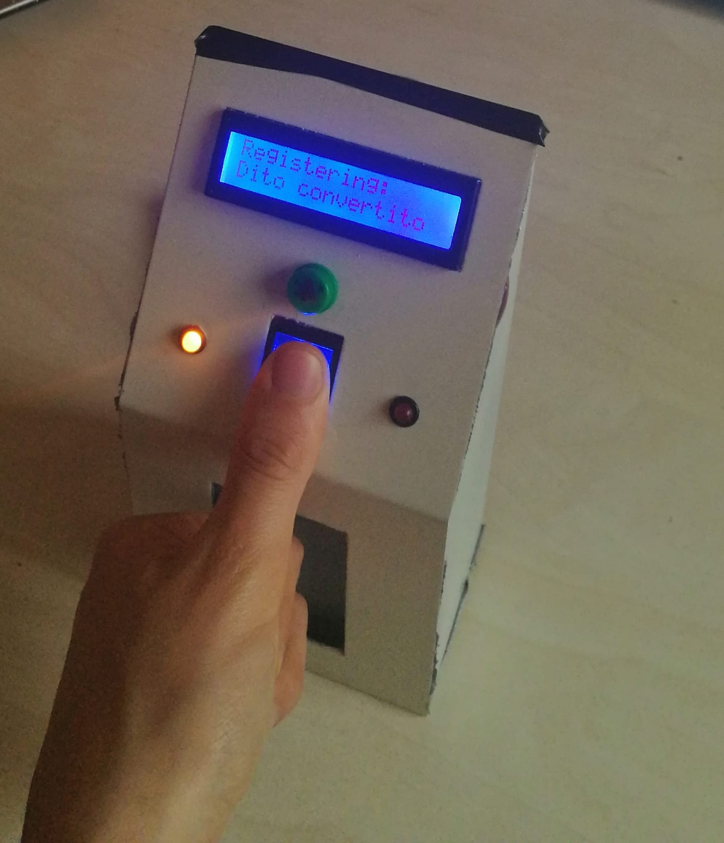
Techincal overview
To satisfy such requirements, an hybrid device was needed, consisting in 2 parts:
A physical device: powered by Arduino, contains various modules such as a fingerprint reader and a lcd screen.

Slide 14
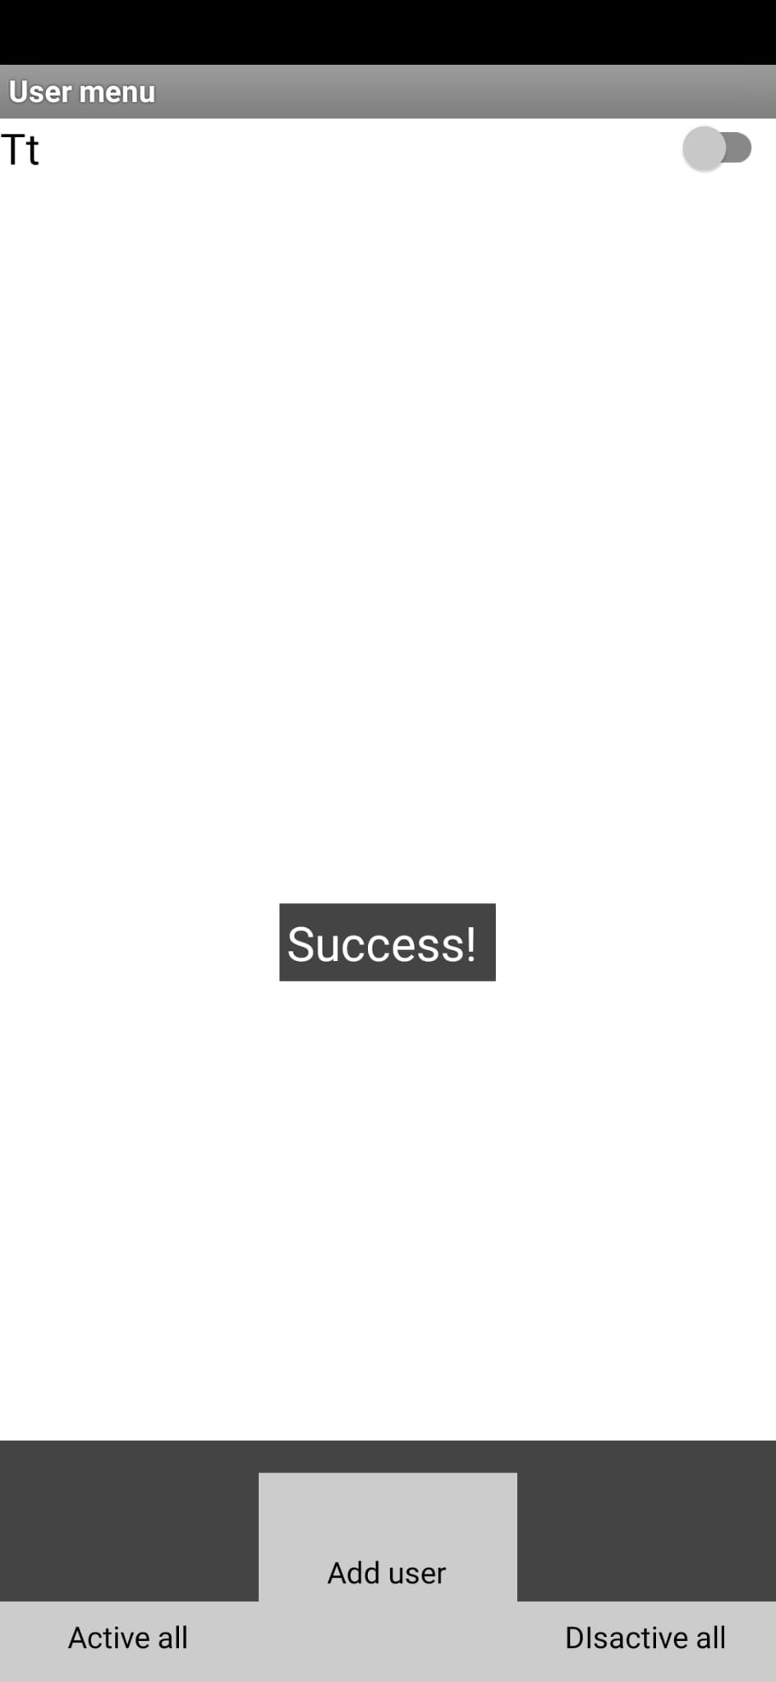
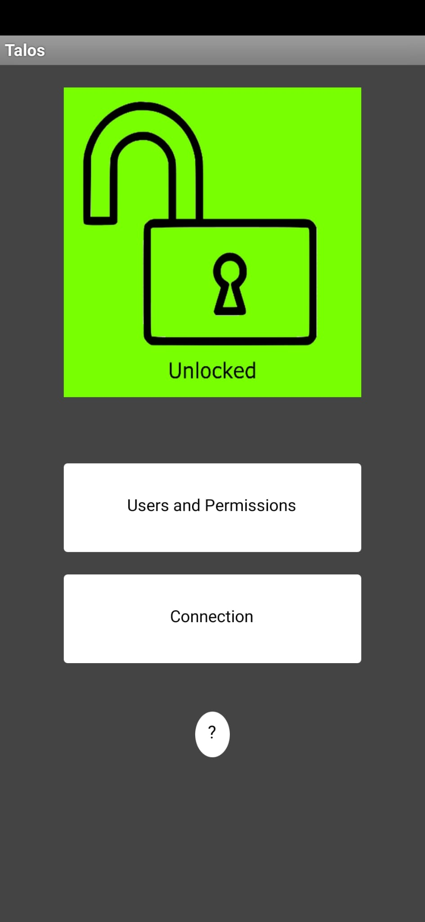
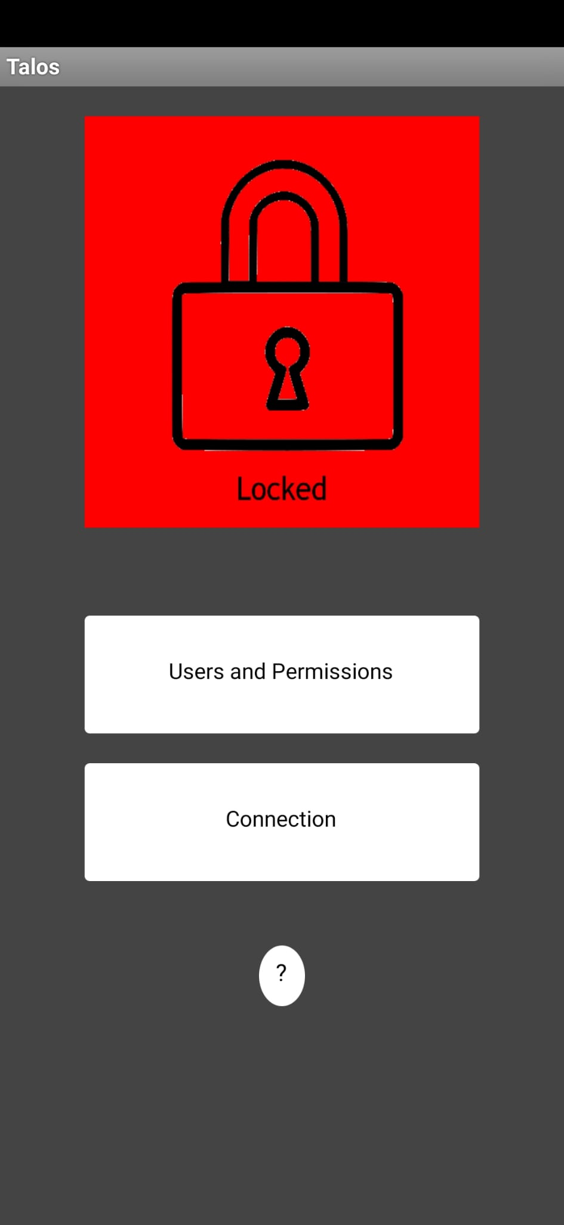
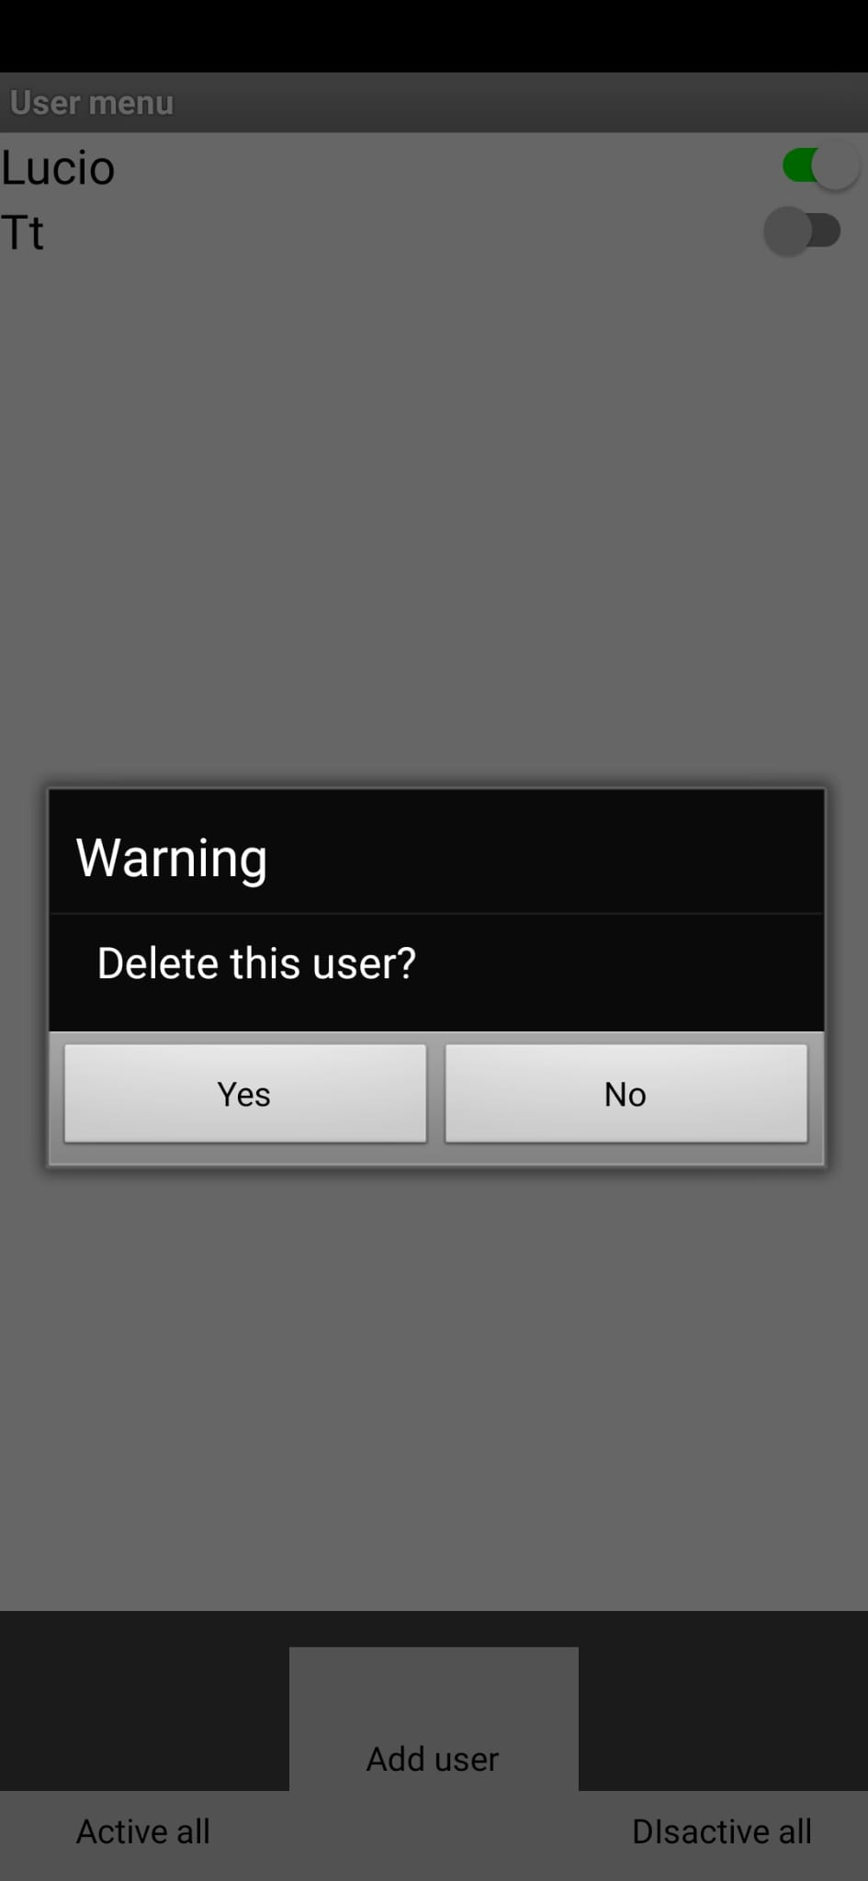
Techincal overview
To satisfy such requirements, an hybrid device was needed, consisting in 2 parts:
An android app: able to connect to the device through bluetooth connection.

Slide 15
Implementation
Here a quick video of the final implementation in action:

Slide 16
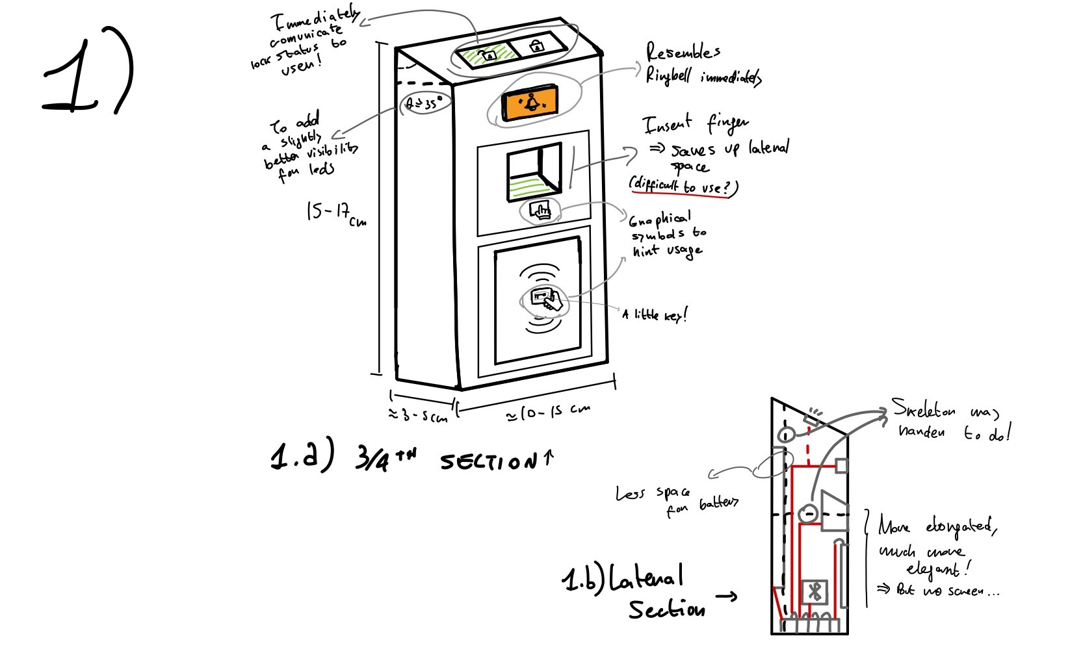
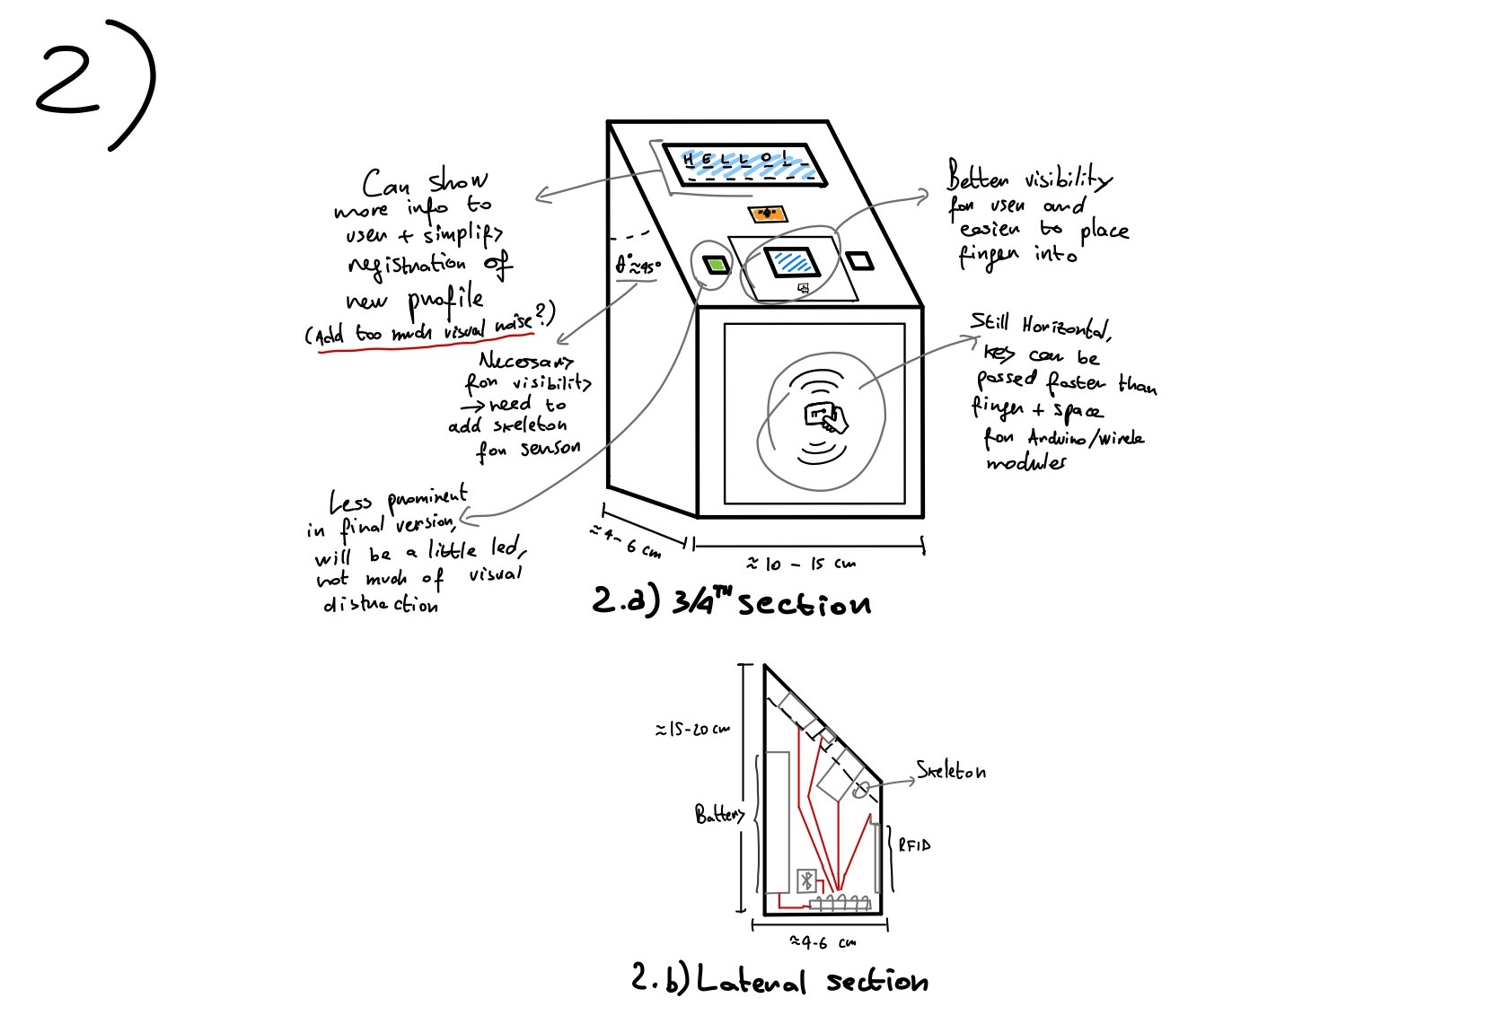
Usability Test
To develop the system 3 different test were done:
Designing stage: In this stage a simple choice was presented to a small test group, consisting in chosing the favourite design for the physical device.

Slide 17
Usability Test
To develop the system 3 different test were done:
Designing stage: In this stage a simple choice was presented to a small test group, consisting in chosing the favourite design for the physical device.
Raw prototype stage: here the same group as before tested a raw version of the device, suggesting adding a buzzer for the sound feedback and other small visual improvements.

Slide 18
Usability Test
To develop the system 3 different test were done:
Designing stage: In this stage a simple choice was presented to a small test group, consisting in chosing the favourite design for the physical device.
Raw prototype stage: here the same group as before tested a raw version of the device, suggesting adding a buzzer for the sound feedback and other small visual improvements.
Final usability test: a more structured test for the device.

Slide 19
Final Usability Test
The final usability test was structured in a series of 6 task, for a group of 5 people.
Here the tasks requested:
Open the app and connect to the device;
Unlock and then lock the door;
Register a new fingerprint profile;
Give entrance permissions to the new profile;
Delete permanently the newly created profile.

Slide 20
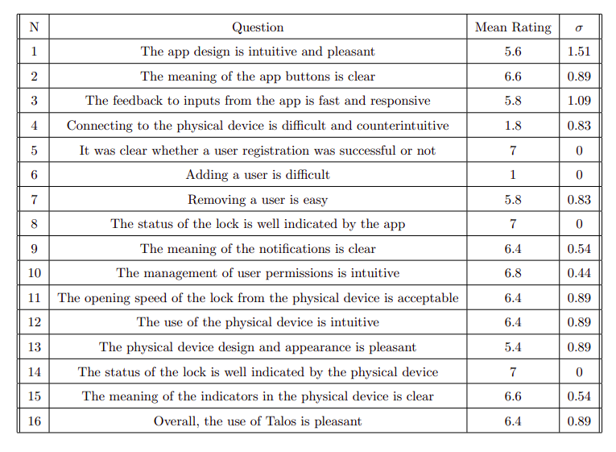
Usability Test - results
Here we can see the results from the test seen before:

Slide 21
Usability Test - results
Summarizing the results we can say that:
The app seems to be intuitive and pleasant enough;
The app also overall lacks in appearance;
Particularly critical is the action of deletion of an user;
After asking how to improve the usability of the app the subjects suggested to present a brief tutorial screen when first opening the app.
Its worth to be noted that no user actually pressed the help button when trying the app.

Slide 22
Conclusions
After the usability testing, we can say that:
Presenting an initial tutorial seems to be a crucial to boost the initial intuitiveness;
A possible addition to the system may be a physical key for entrance;
Overall, we found that the system seems to work absolving most of the principal needs found in the needfinding process.

